Slide 1
Recreating FAMOUS WORKS of ART: MIDDLE AGES – 20th CENTURY
PORTRAITS / GENRE (people in action)

Slide 3
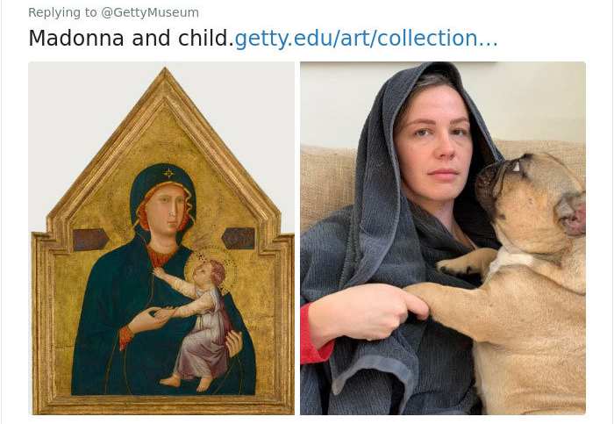

Slide 4
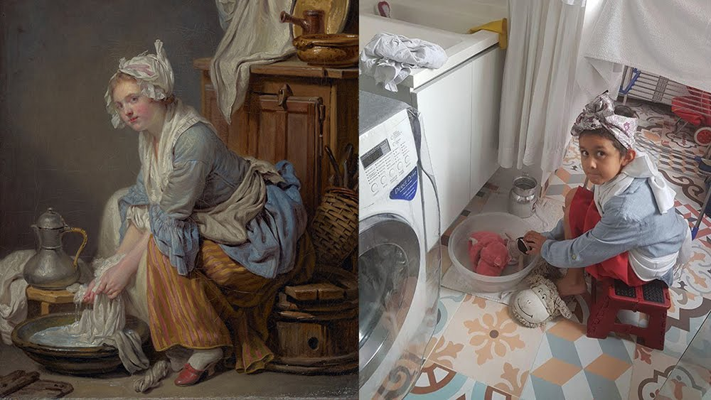

Slide 5
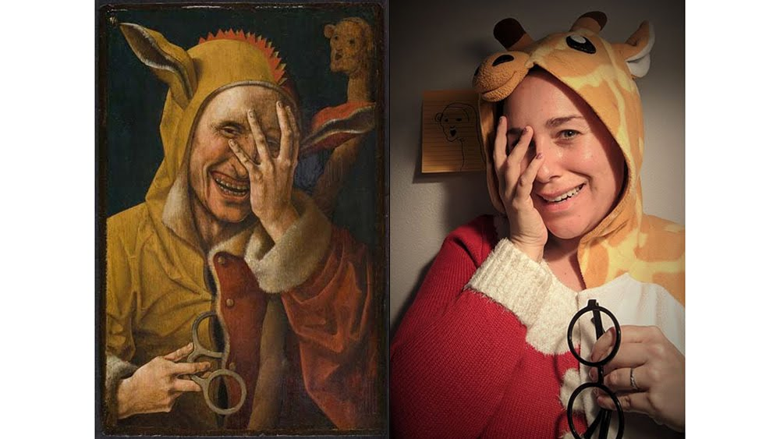

Slide 6
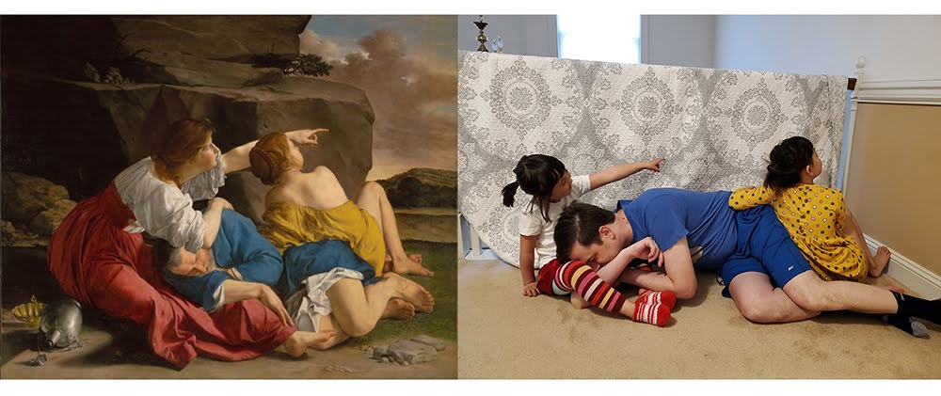

Slide 7
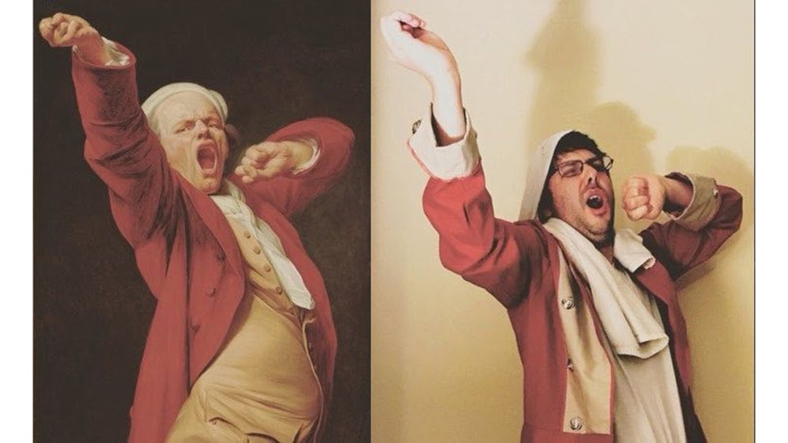

Slide 8
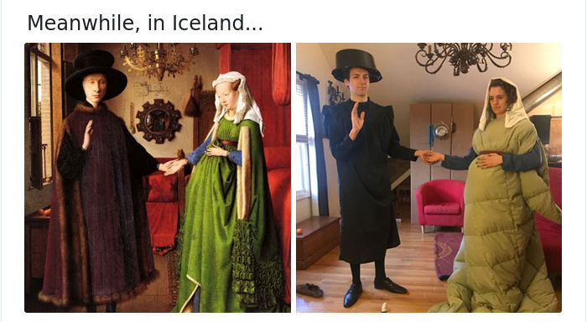

Slide 9
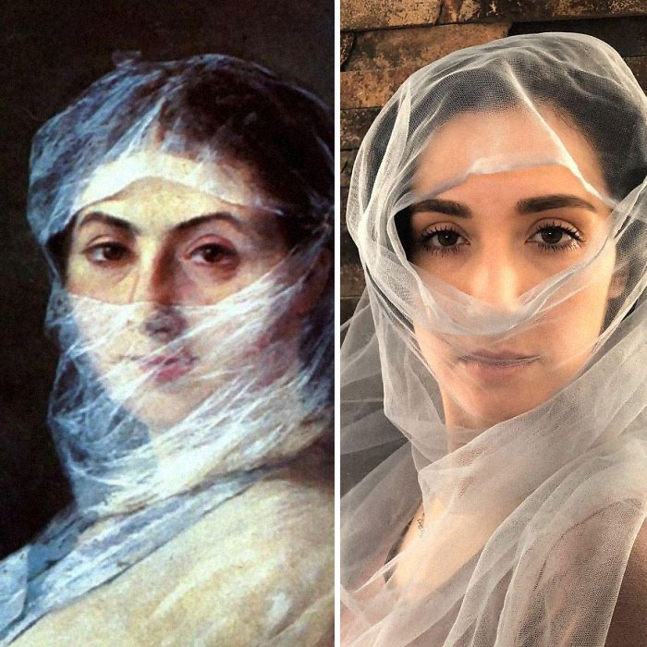

Slide 10
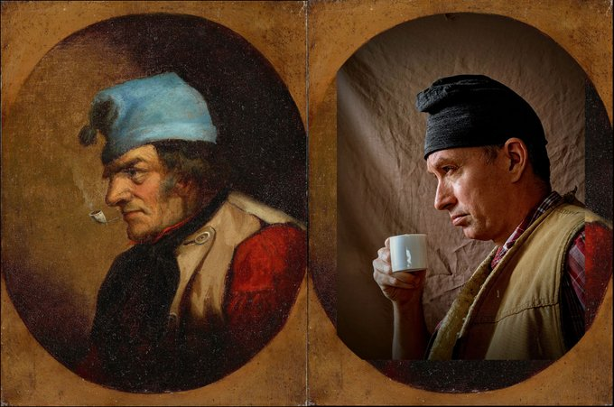

Slide 11
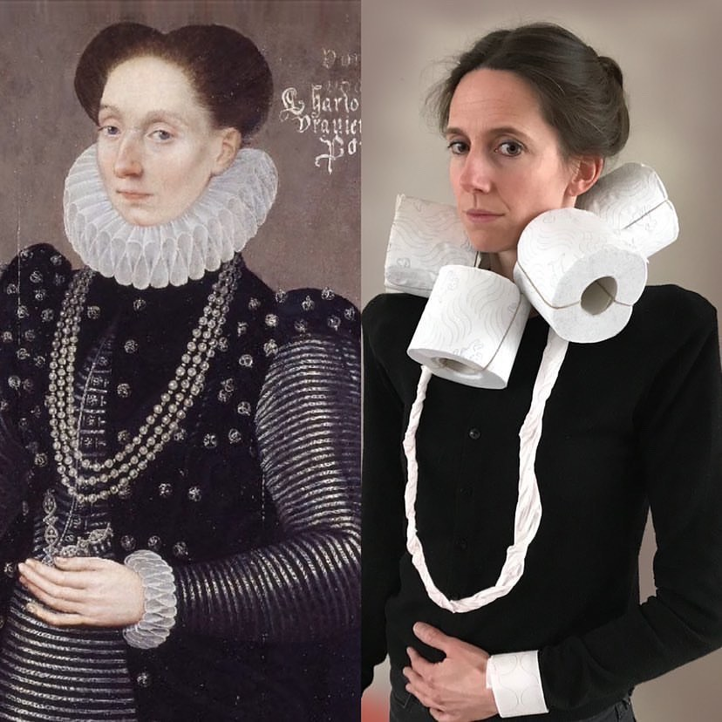

Slide 13
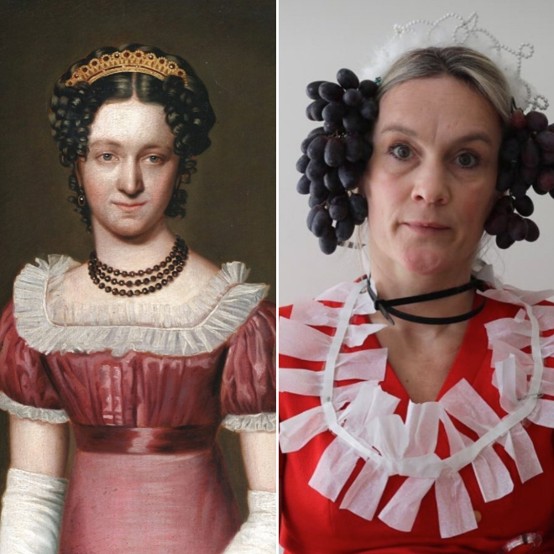

Slide 16
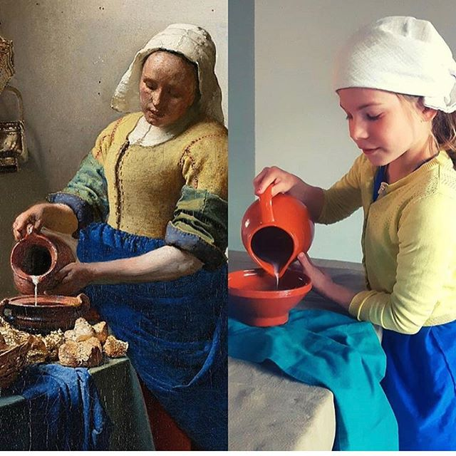

Slide 17
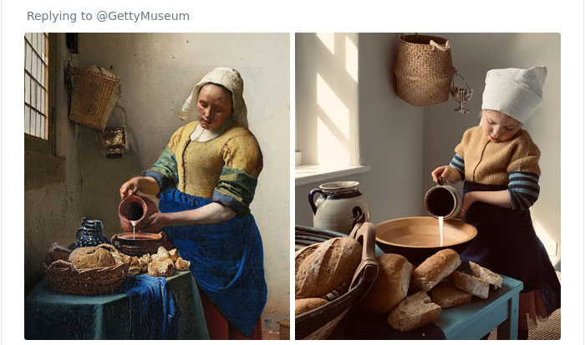

Slide 18
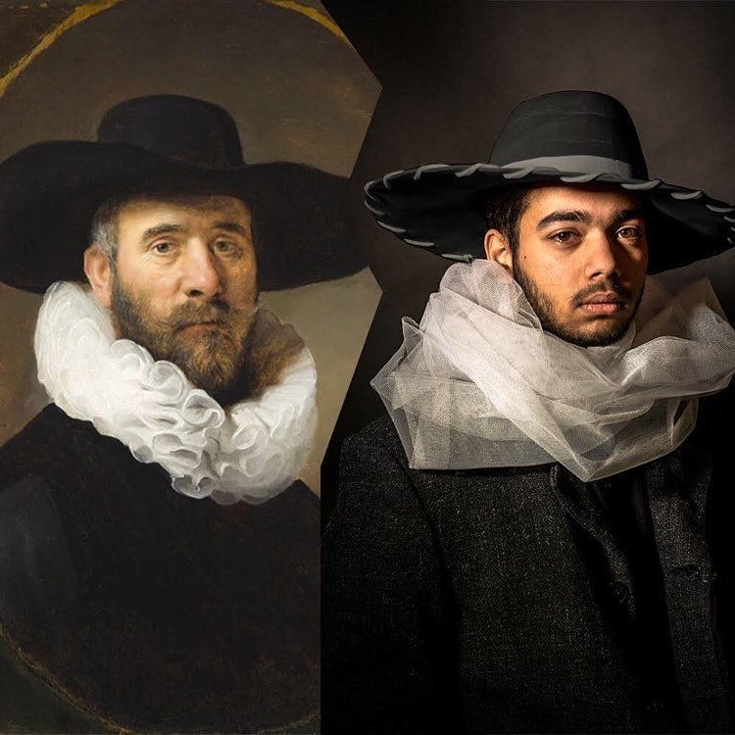

Slide 19
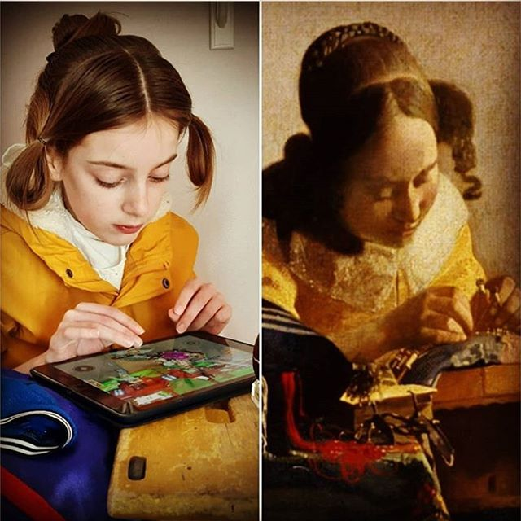

Slide 20
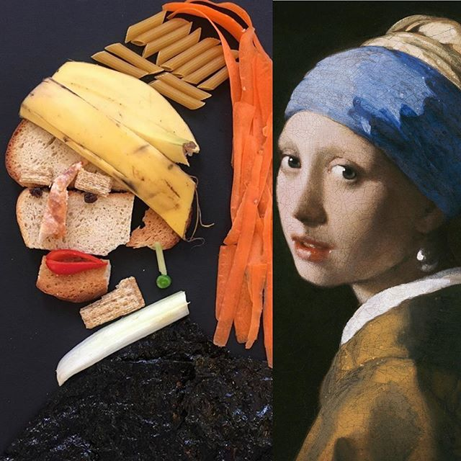

Slide 21
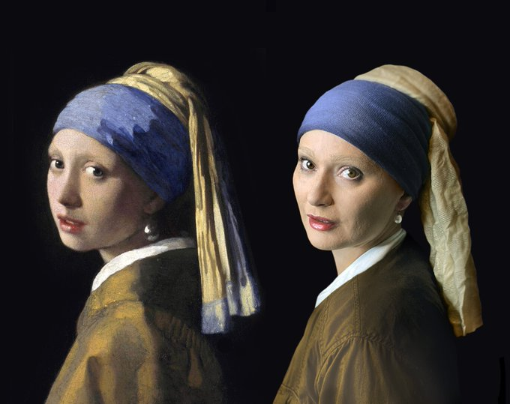

Slide 22
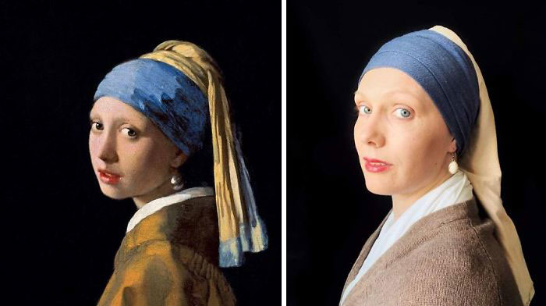

Slide 23
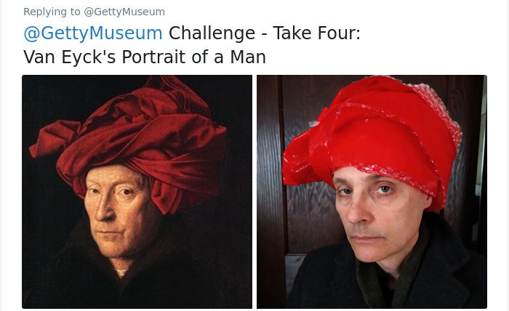

Slide 24
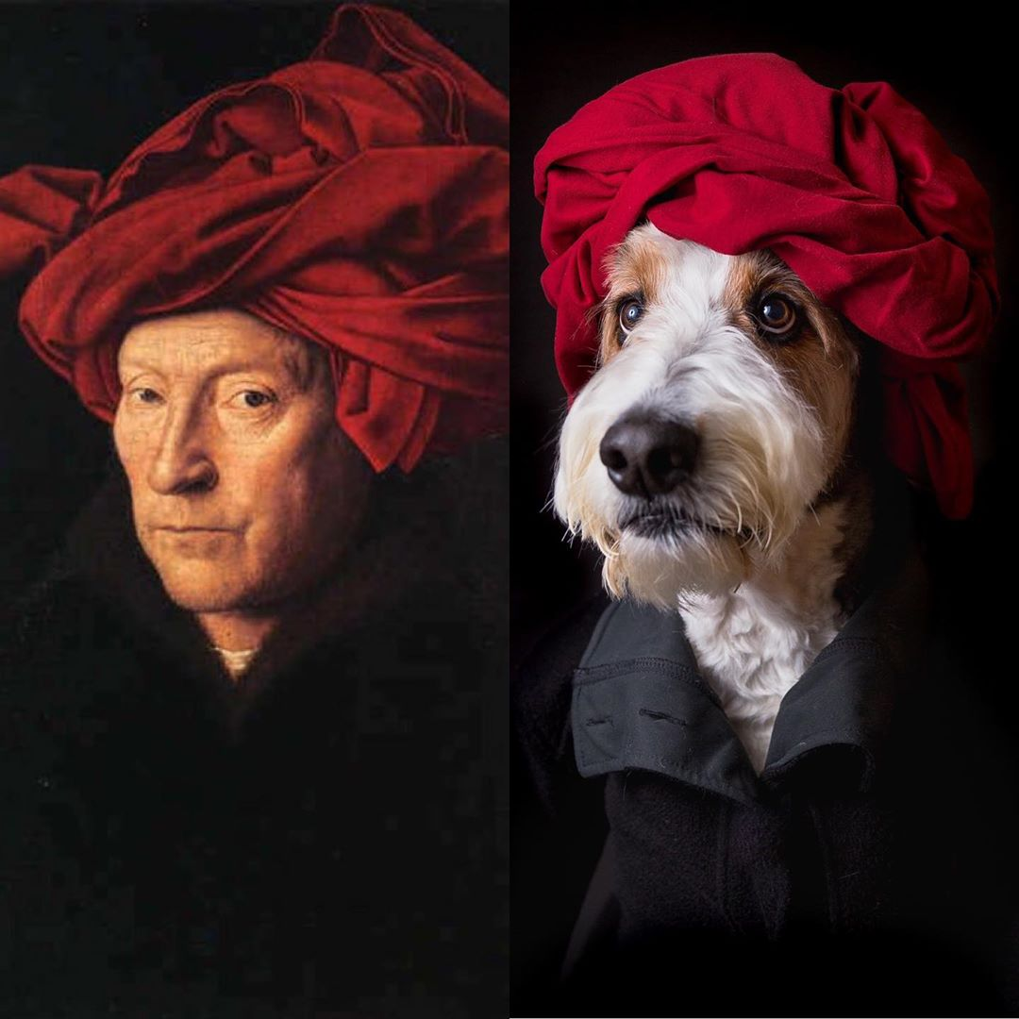

Slide 25
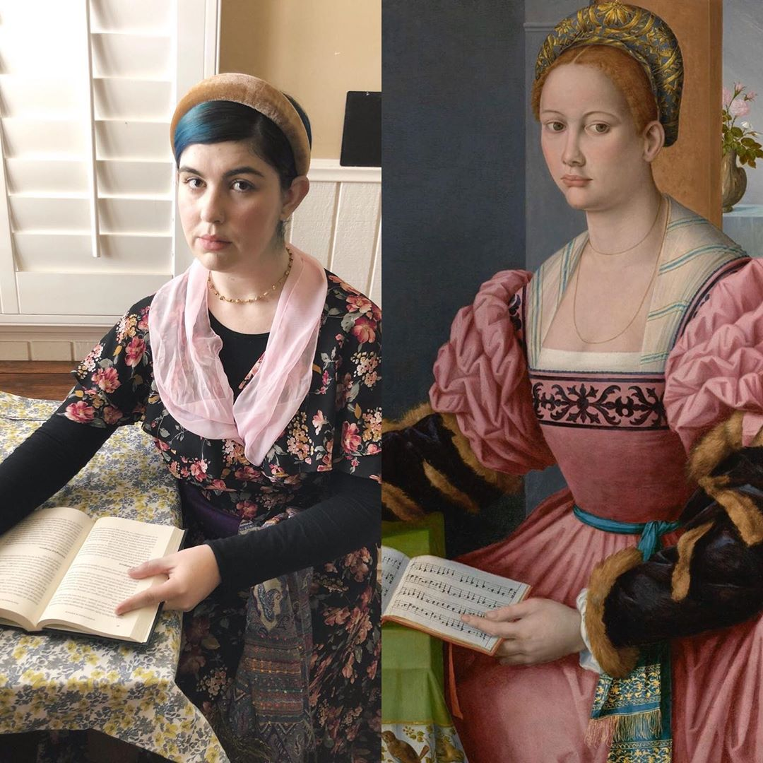

Slide 26
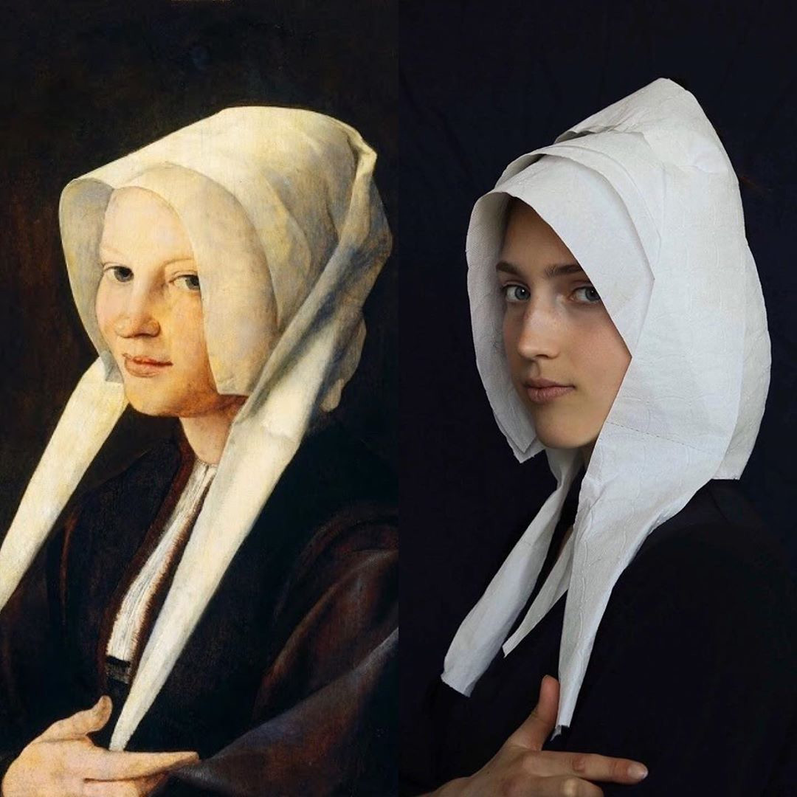

Slide 27
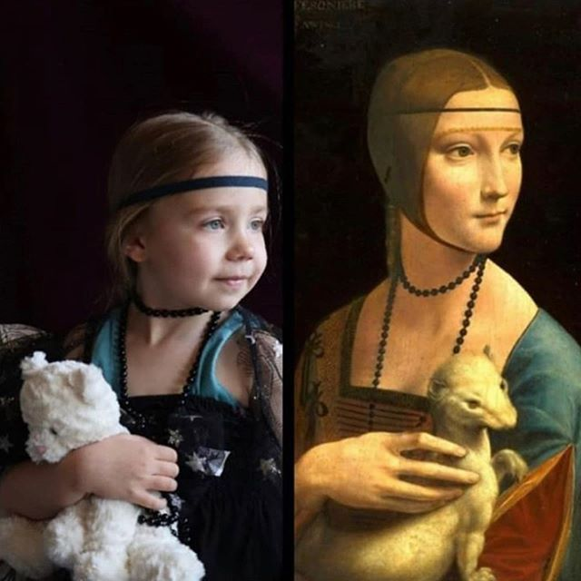

Slide 28
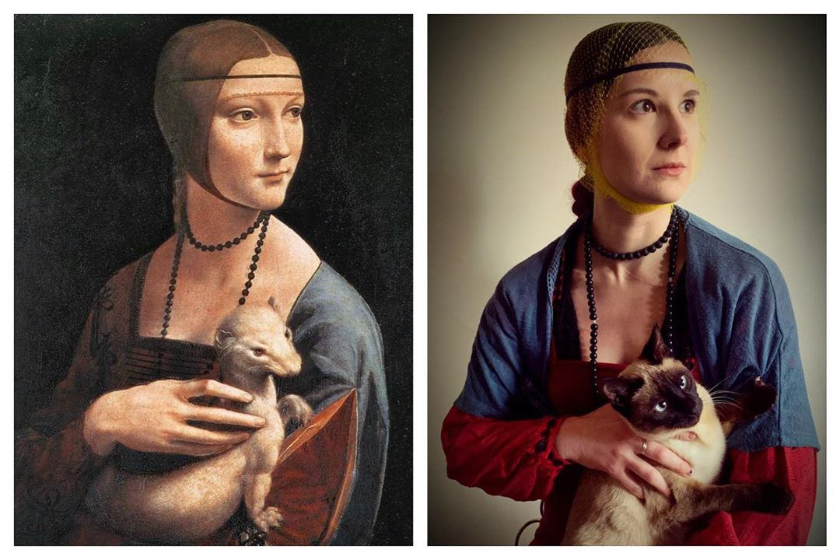

Slide 30
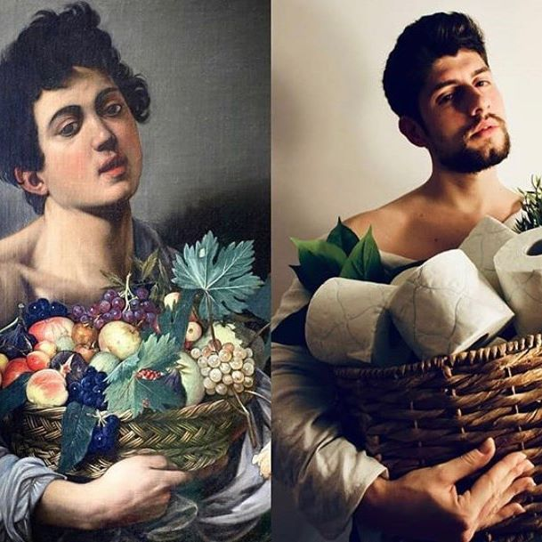

Slide 32
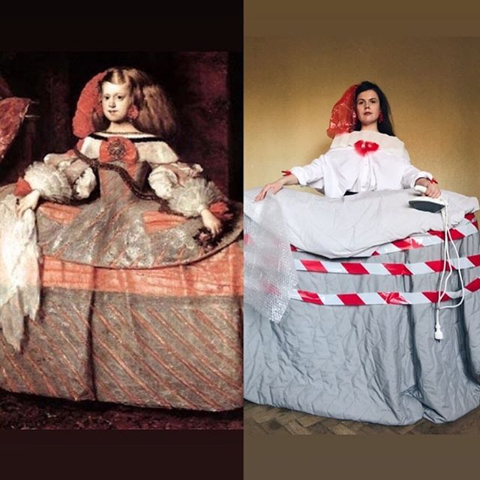

Slide 35
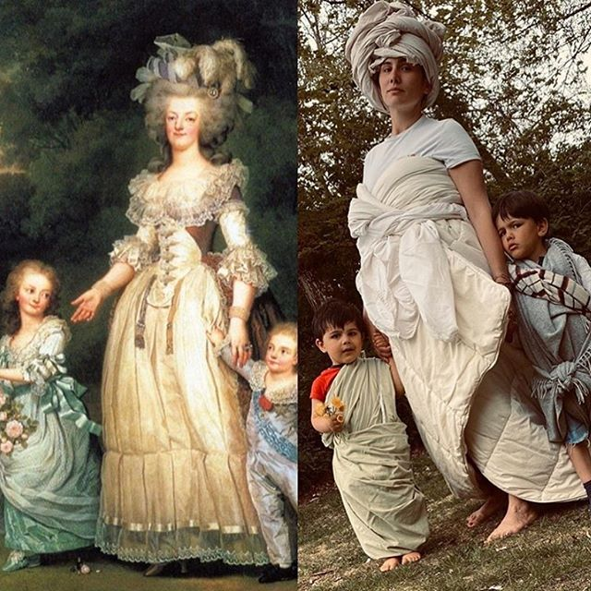

Slide 36
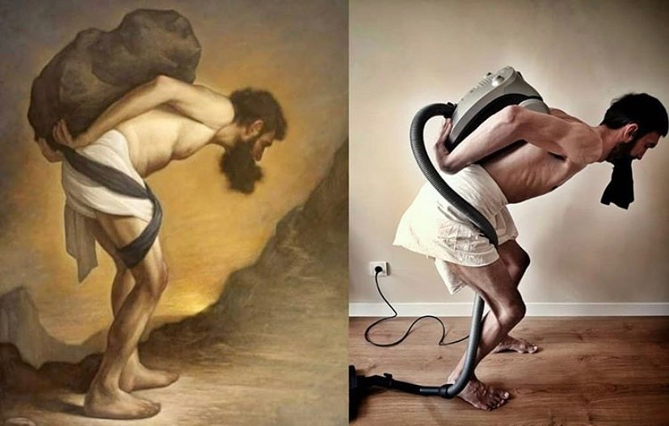

Slide 37
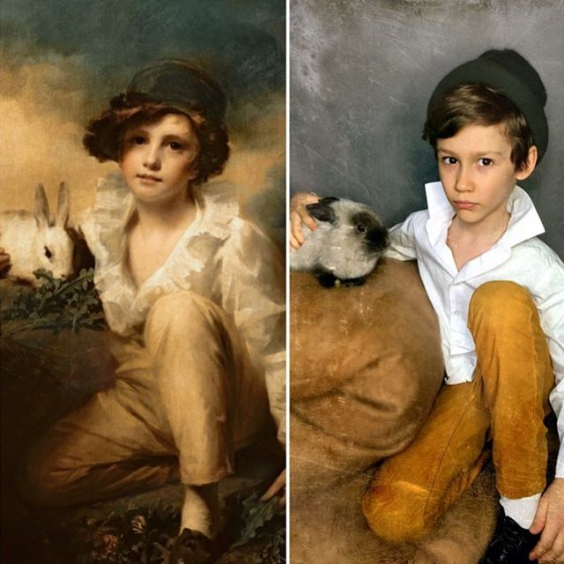

Slide 38
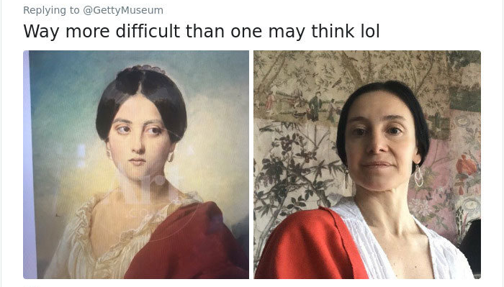

Slide 39
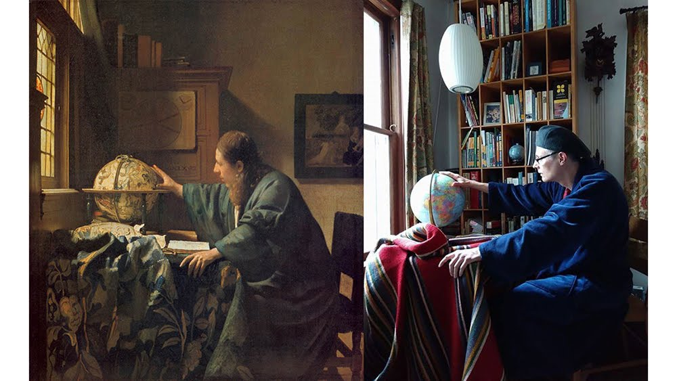

Slide 40
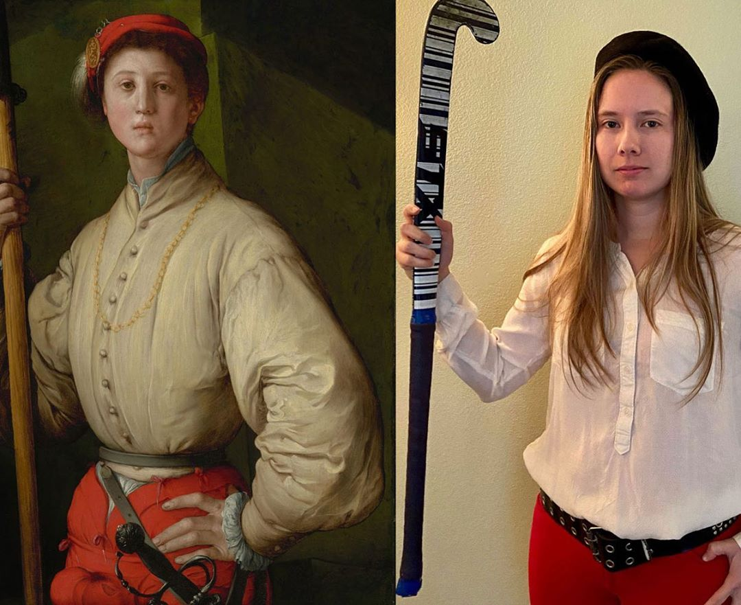

Slide 41
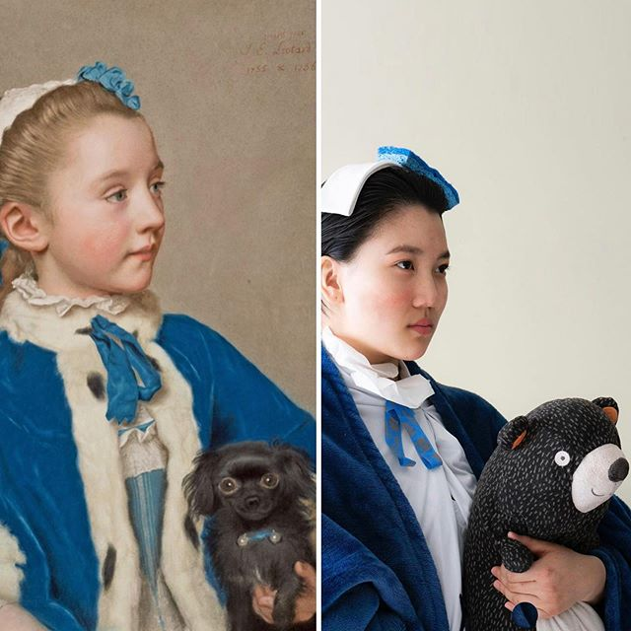

Slide 43
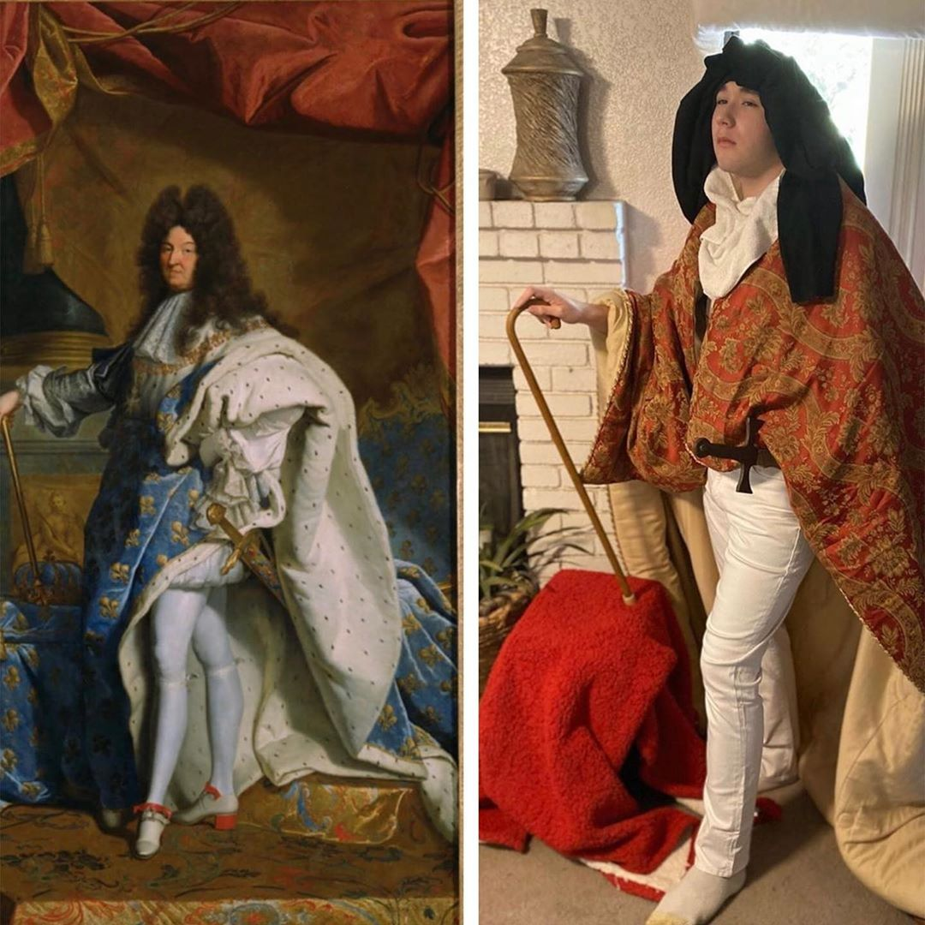

Slide 44
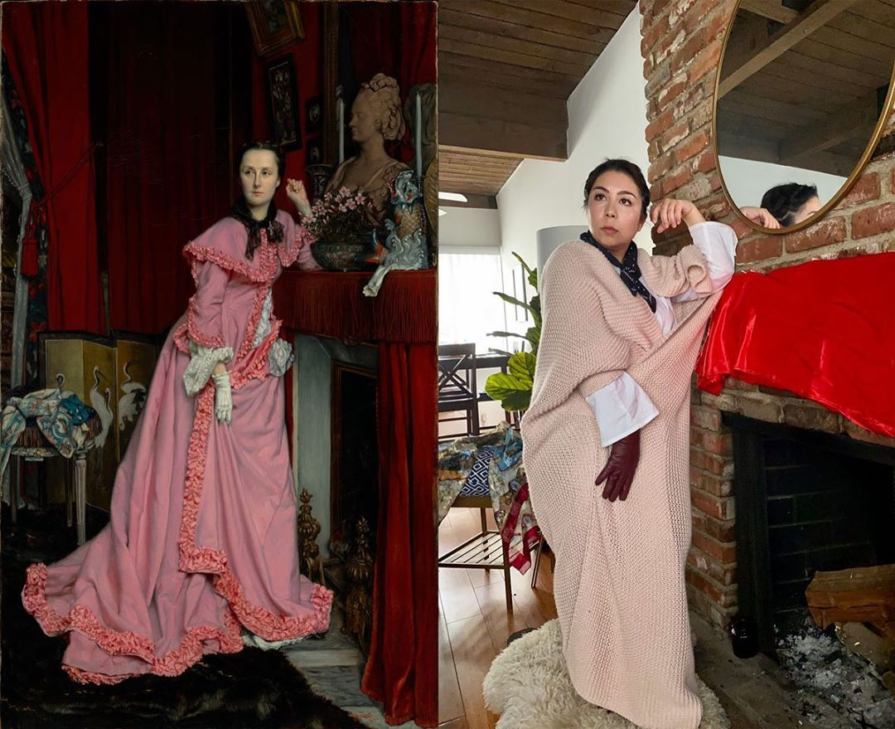

Slide 45
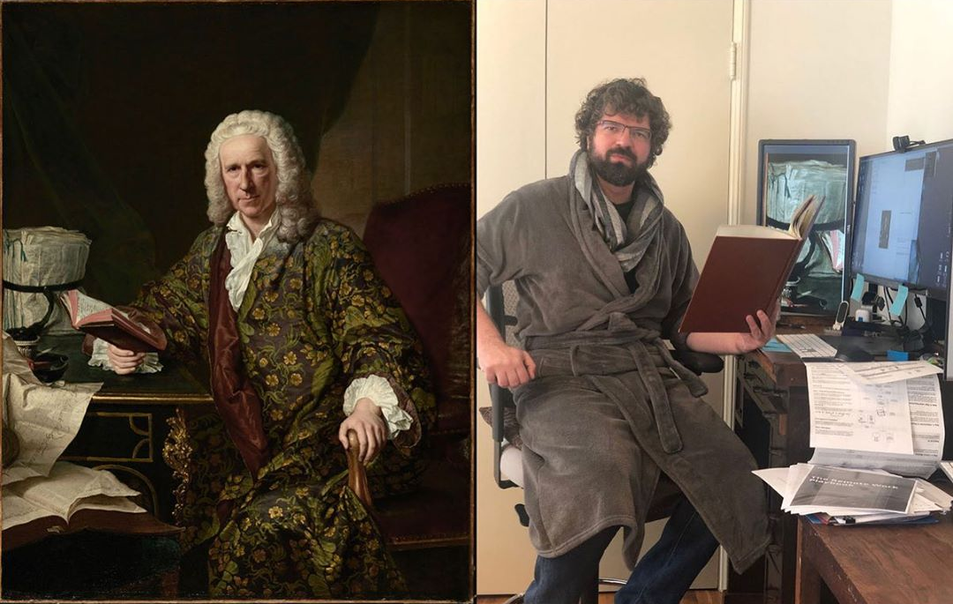

Slide 47
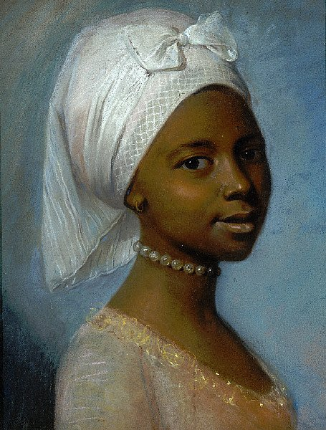
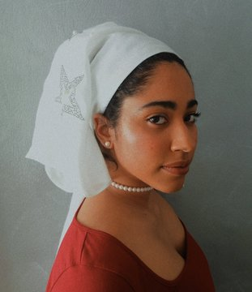
"Portrait of a young woman" de Jean Etienne L.

Slide 48
https://www.thisiscolossal.com/2020/04/covid-19-getty-recreations/
https://www.boredpanda.com/art-recreation-at-home-museum-challenge/?utm_source=google&utm_medium=organic&utm_campaign=organic
https://www.boredpanda.com/famous-painting-remakes/?utm_source=google&utm_medium=organic&utm_campaign=organic
https://news-artnet-com.cdn.ampproject.org/v/s/news.artnet.com/art-world/instagram-recreate-famous-artworks-1819776/amp-page?amp_js_v=a3&amp_gsa=1&usqp=mq331AQFKAGwASA%3D
https://www-refinery29-com.cdn.ampproject.org/v/s/www.refinery29.com/amp/en-us/2020/04/9689396/getty-museum-challenge-twitter?amp_js_v=a3&amp_gsa=1&usqp=mq331AQFKAGwASA%3D#aoh=15870801890187&referrer=https%3A%2F%2Fwww.google.com&amp_tf=From%20%251%24s&ampshare=https%3A%2F%2Fwww.refinery29.com%2Fen-us%2F2020%2F04%2F9689396%2Fgetty-museum-challenge-twitter
https://www.demilked.com/people-recreate-art-at-home/
https://www.sadanduseless.com/recreated-art/
https://amp-classicfm-com.cdn.ampproject.org/v/s/amp.classicfm.com/discover-music/humour/recreating-famous-paintings-home-quarantine/?amp_js_v=a3&amp_gsa=1&usqp=mq331AQFKAGwASA%3D#aoh=15870801890187&referrer=https%3A%2F%2Fwww.google.com&amp_tf=From%20%251%24s&ampshare=https%3A%2F%2Fwww.classicfm.com%2Fdiscover-music%2Fhumour%2Frecreating-famous-paintings-home-quarantine%2F

